Slide 1
Malaria Cell Detection
Using malaria cell images dataset

Slide 2
Team Members
Name | ID
نورهان أيمن جوده عبدالرحمن | 20201700938
مروة نورالدين أبوسريع | 20201700796
نانسي مصطفى سعد صابر | 20201700907
ندا محمد أنور محمد | 20201700910
هبة محروس رمضان محروس | 20201700960
محمود نادر محمود محمود | 20201700785

Slide 3
Dataset Link
https://www.kaggle.com/datasets/iarunava/cell-images-for-detecting-malaria

Slide 4
Introduction
Malaria, a life-threatening disease caused by Plasmodium parasites, is a major global health concern.
So, we will develop deep learning Models for classification of malaria
cell images

Slide 5
Objective
The goal of our project is to distinguish between two classes :
Uninfected Cells: Healthy red blood cells without malaria infection.
Parasitized Cells: Red blood cells infected with Plasmodium parasites

Slide 6
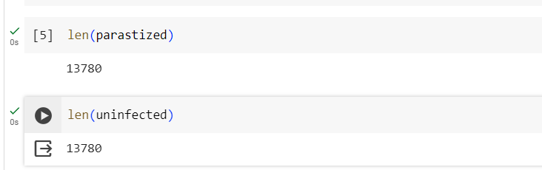
Dataset Description
The dataset consists of two classes : Uninfected Cells & Parasitized image Cells

Slide 7
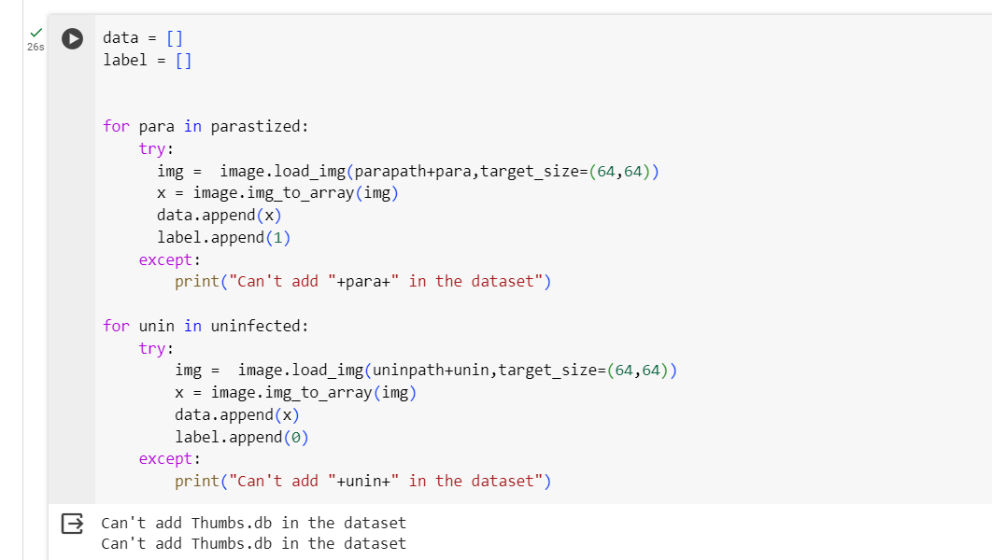
prepare the dataset

Slide 8
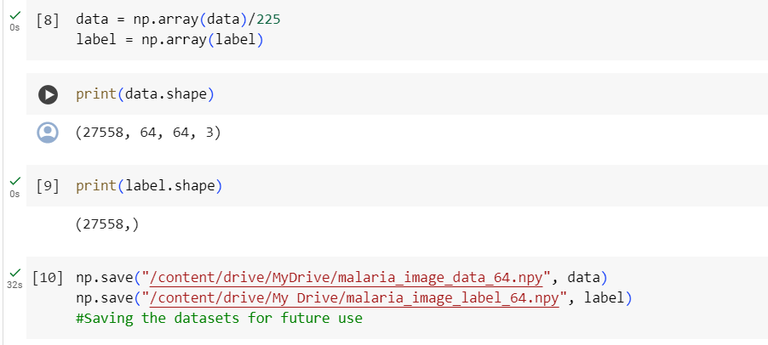
Dataset preprocessing

Slide 9
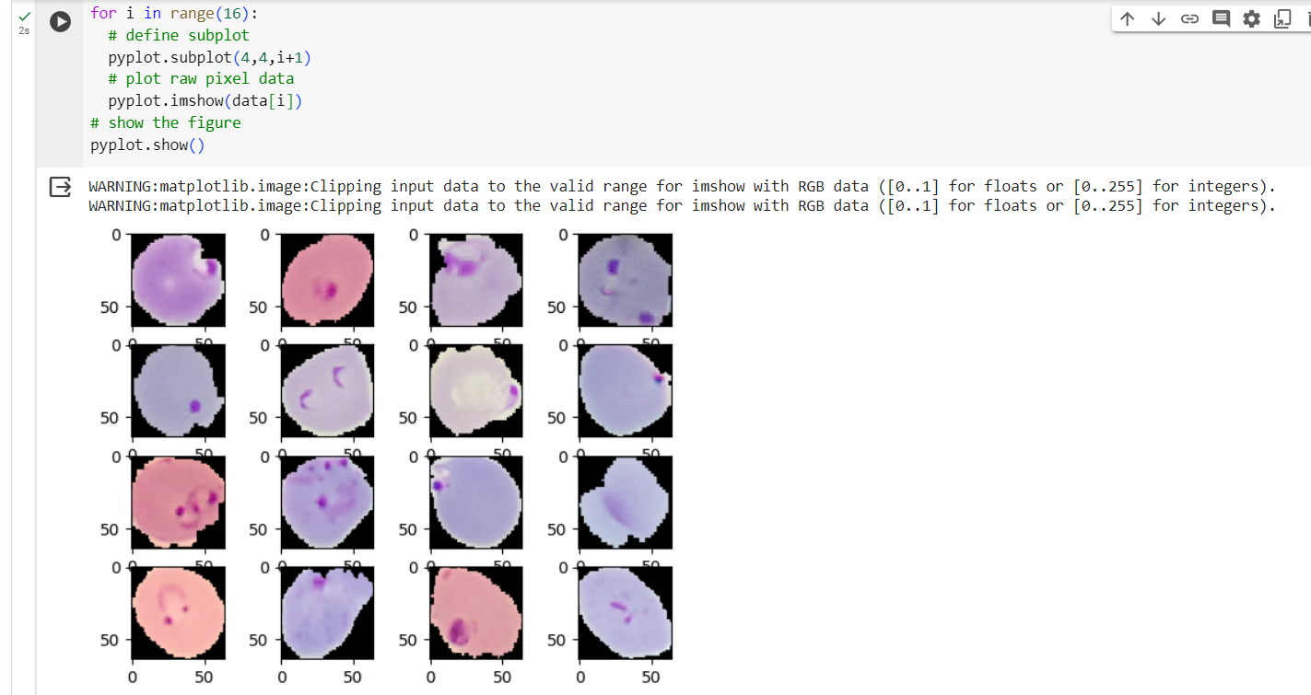
Samples from the dataset

Slide 10
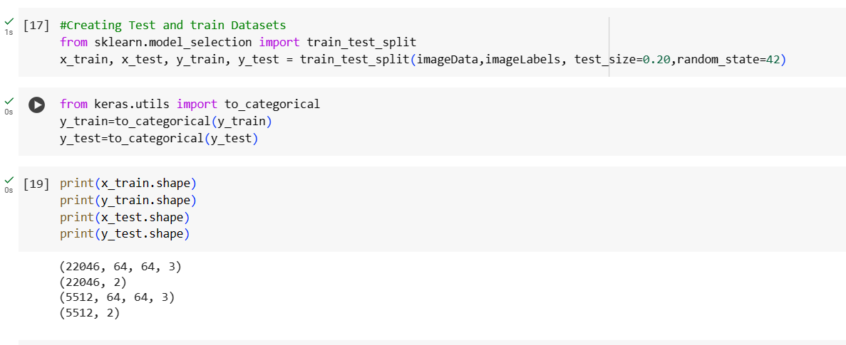
Split the dataset into train & test

Slide 11
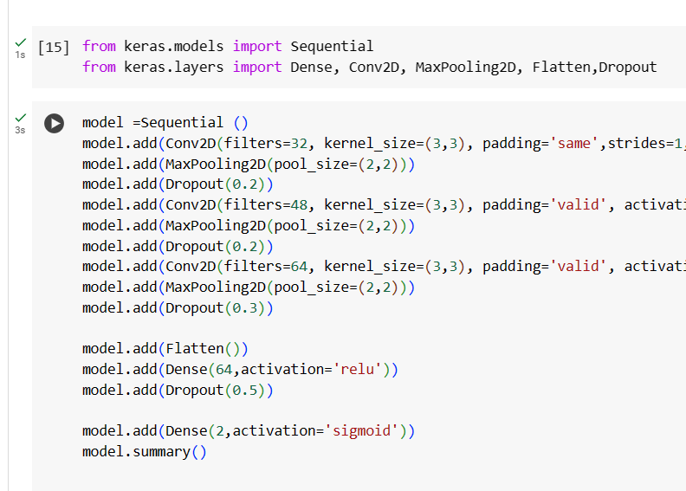
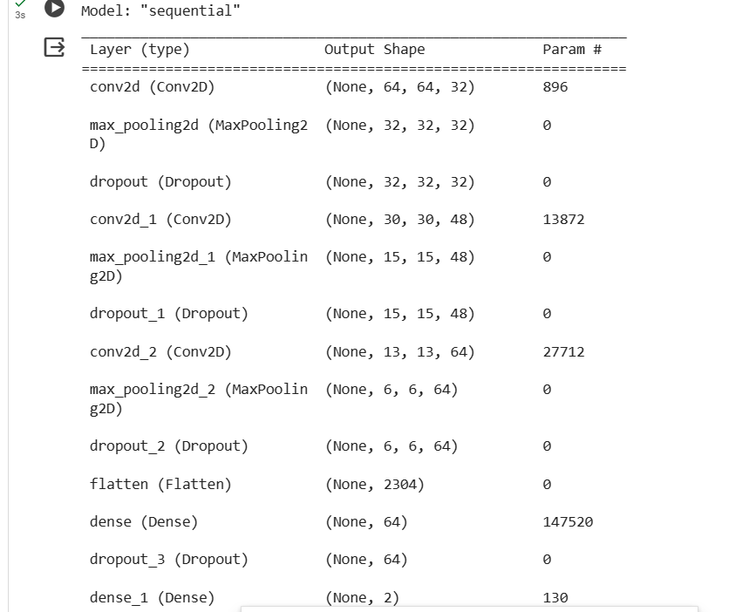
Model from scratch

Slide 12


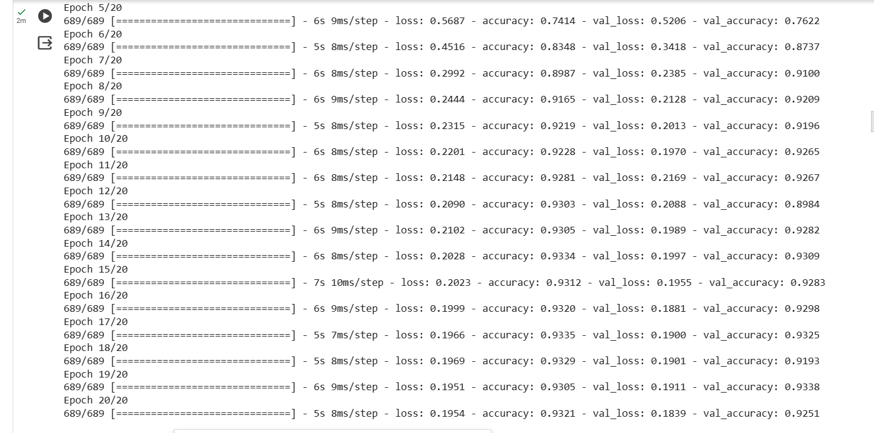
Fit model from scratch

Slide 13
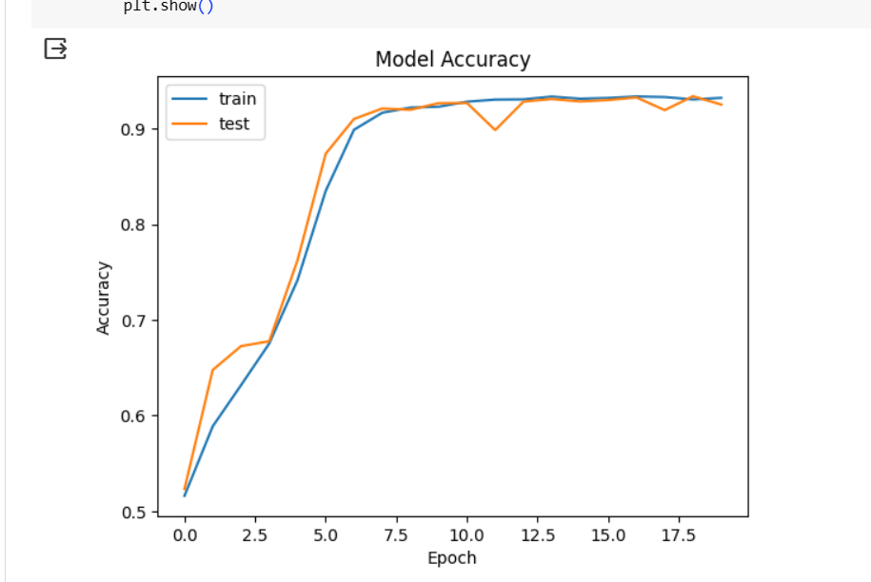
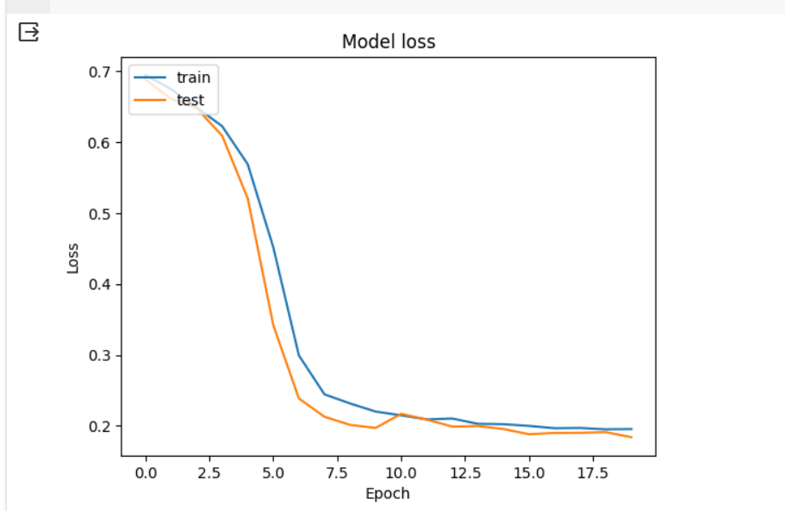

Slide 14
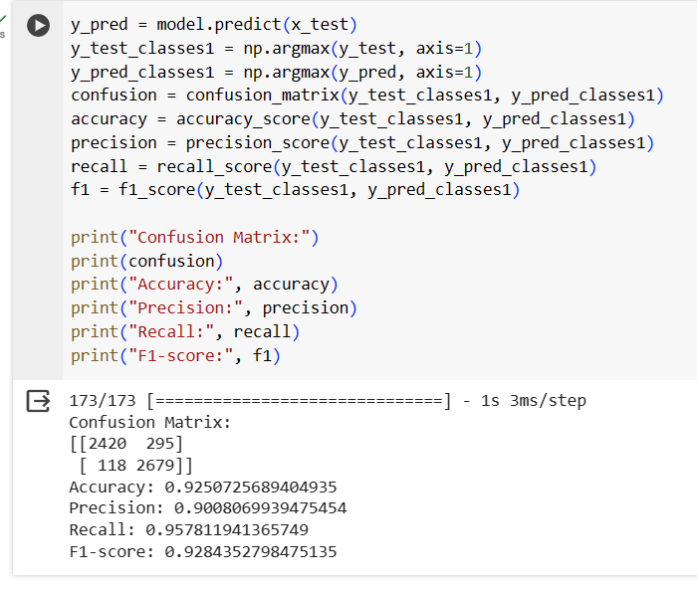
Model Evaluation
No overfitting or underfitting

Slide 15
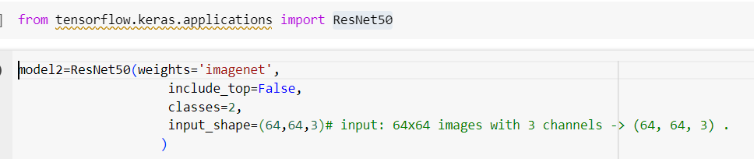
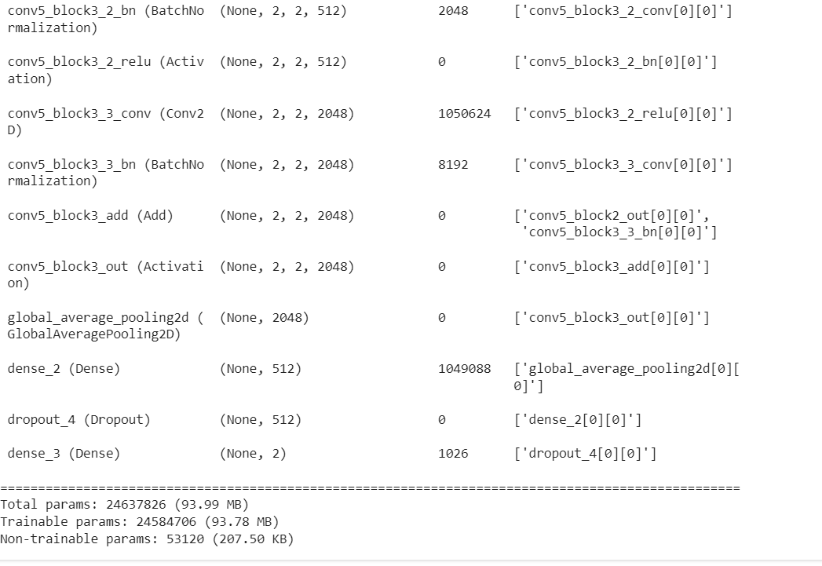
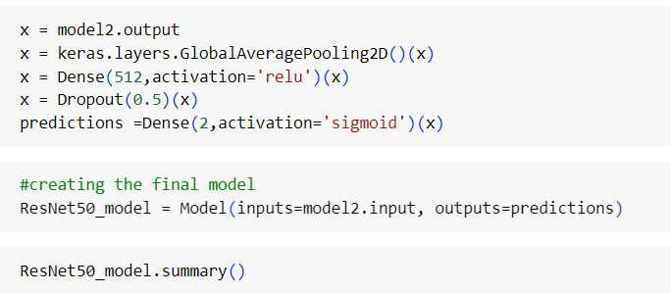
pretrained models
ResNet50 Model

Slide 16
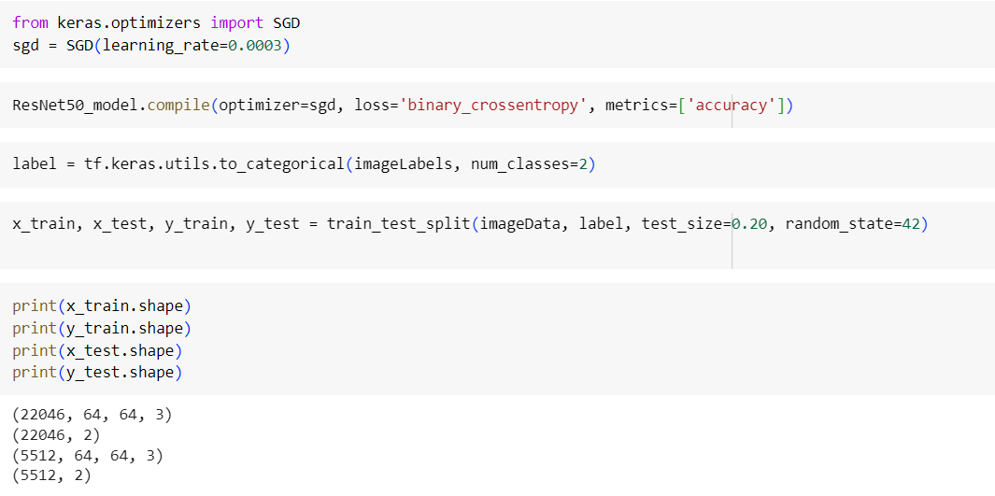
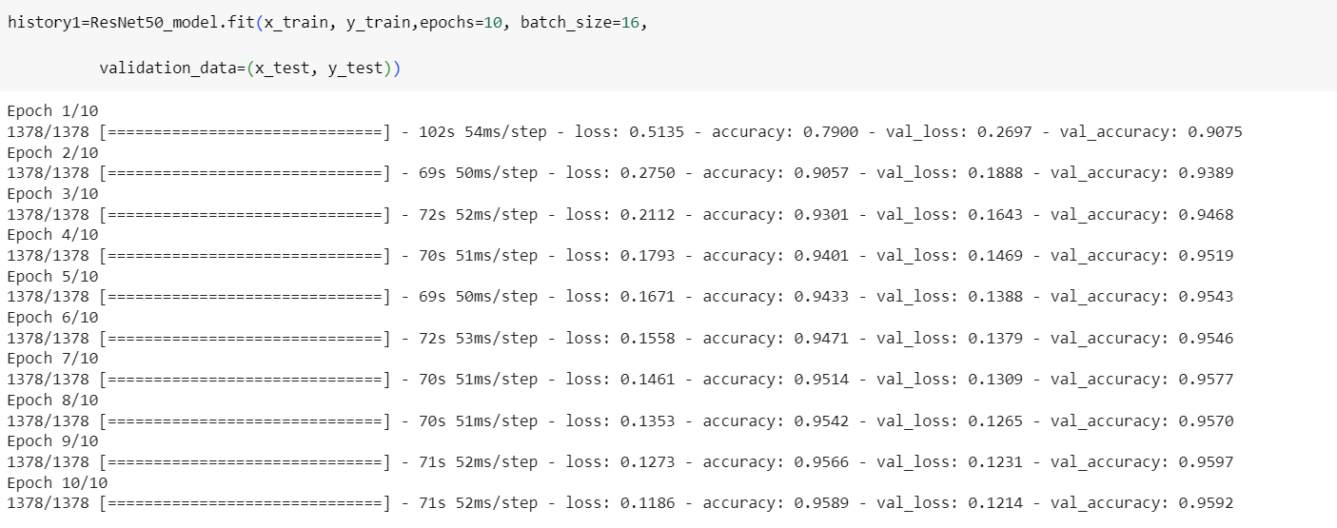
Fit ResNet50 Model

Slide 17
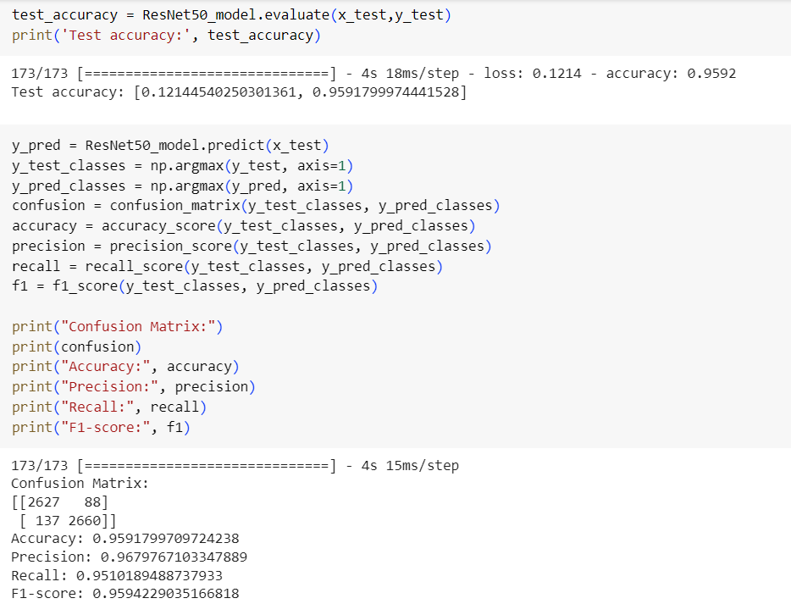
Evaluation ResNet50 Model

Slide 18
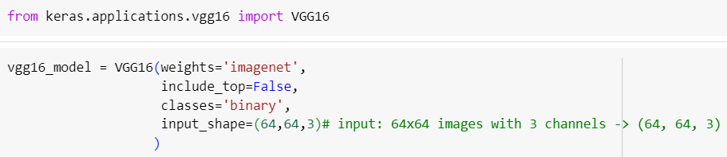
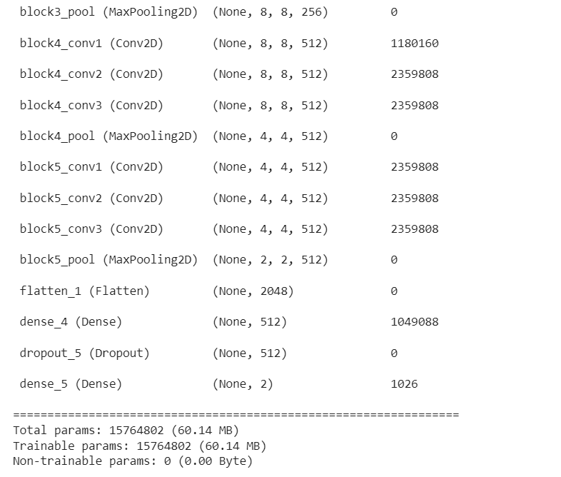
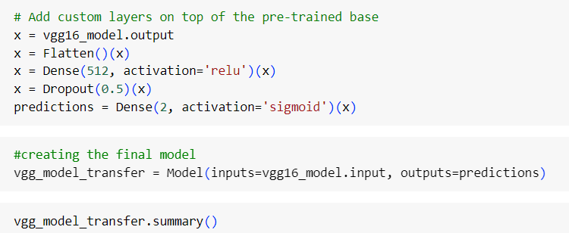
VGG16 Model

Slide 19
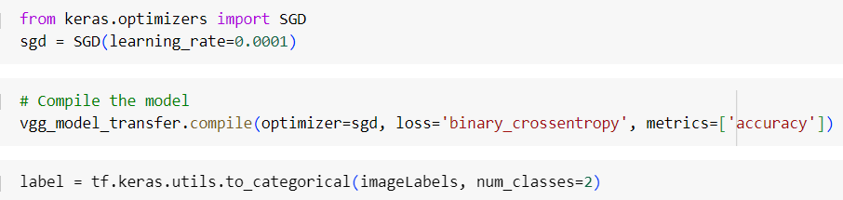

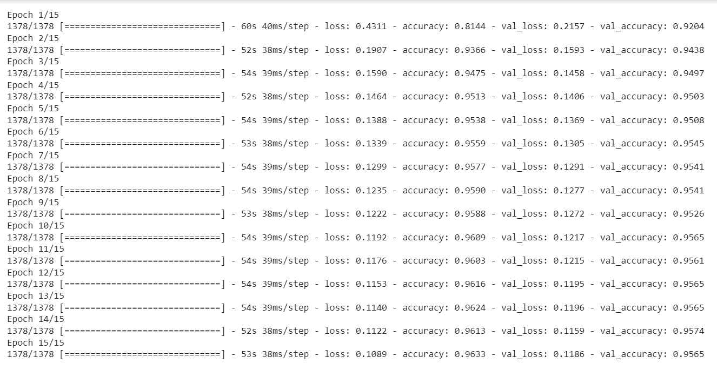
Fit VGG16 Model

Slide 20
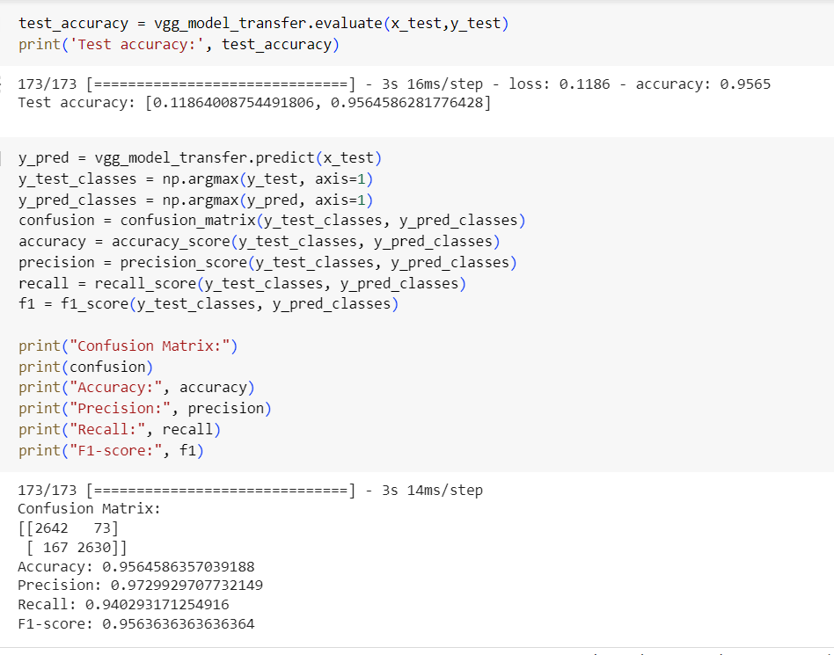
Evaluation VGG16 Model

Slide 21
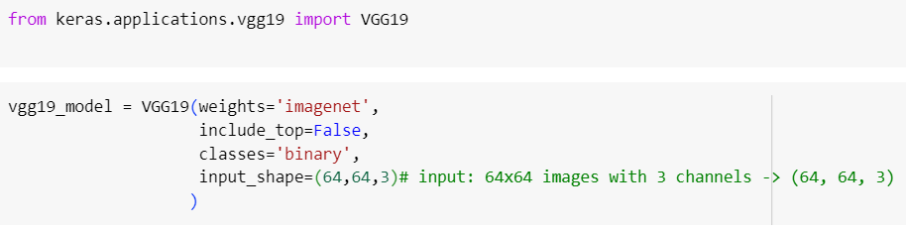
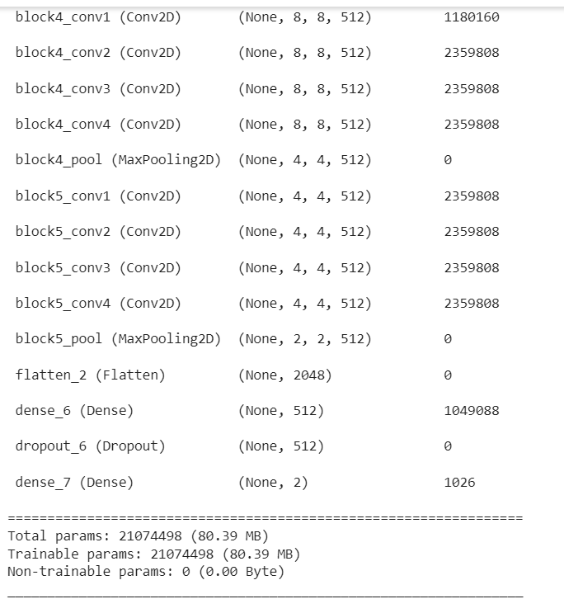
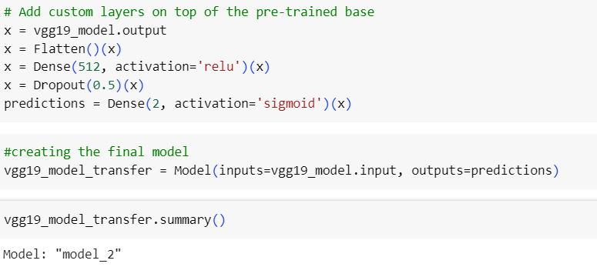
VGG19 Model

Slide 22
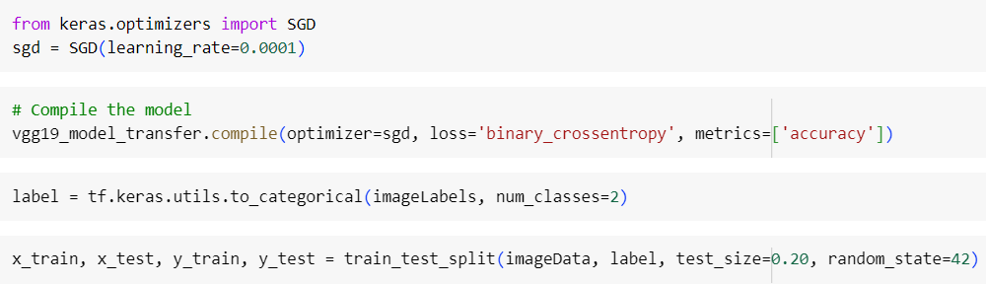
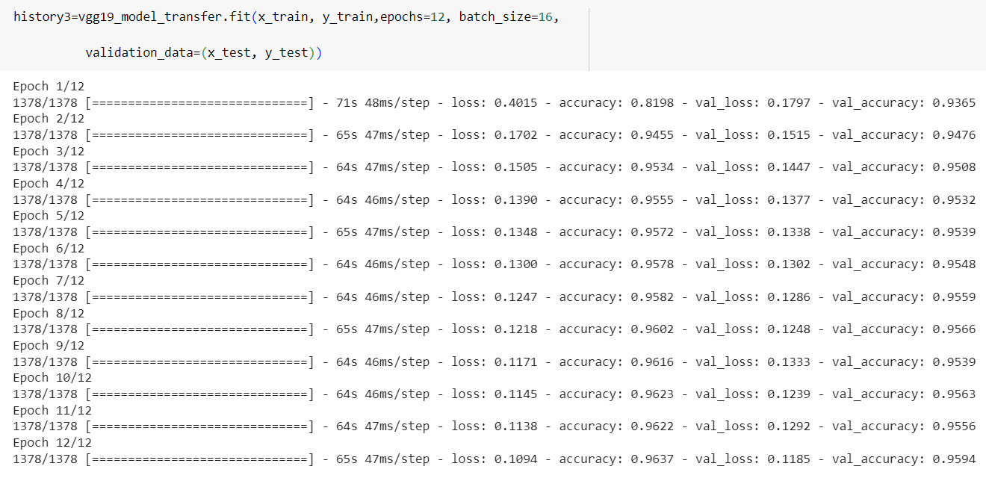
Fit VGG19 Model

Slide 23

Evaluation VGG19 Model

Slide 24
Conclusions
We used preprocessing techniques like normalization to improve the performance.
Build model from scratch consists of (3 convolution layers , 3 maxpooling layers , 4 Dropout layers , flatten layer , and 2 dense layers ) and the accuracy is 93% .
And we also compared different models such as VGG-16,VGG-19 , ResNet-50 and the accuracy of them is 95% , 96% , and 96% respectively

